Slide 1
360 View on Quarkus

Slide 2
Agenda
1
What is Quarkus ?
2
The good and bad
3
Metrics
4
Takeaway
5
Coding Session
6
Q&A

Slide 3
What is Quarkus

Slide 4
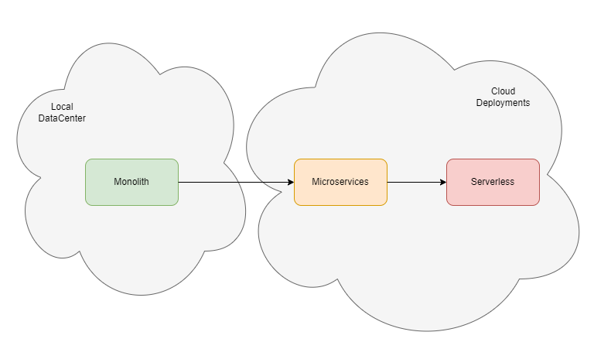
What is Quarkus – Software evolution

Slide 5
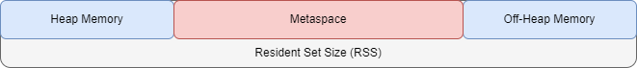
What is Quarkus – Java Runtime overhead
Startup Overhead
Scan classpath
Load jar
Annotation parsing
Build Metadata
Dynamic compilation (JIT)
RAM Overhead
Classes, metadata, compilation

Slide 6
What is Quarkus – Official definition
SUPERSONIC – orders of magnitude faster
SUBATOMIC – orders of magnitude lower resource consumption (memory and disk)
JAVA – still java
A Kubernetes Native Java stack tailored for OpenJDK HotSpot and GraalVM, crafted from the best of breed Java libraries and standards.

Slide 7
What is Quarkus – Practical Definition
Build Tool – Maven/Gradle plugins to augment and optimize compilation (ByteBuddy with a twist)
Framework – Development framework based on CDI and JavaEE standards (JAX-RS, JPA) that incorporates as extensions more and more of the Java space critical components like (Kafka, Mongo, Camel, Redis, Jaeger, etc)
Native Image Optimized for Core functionality but also for all extensions.
Aims for a better developer experience by simplifying coding(unified configuration) and processes (docker, Kubernetes templating available ootb).

Slide 8
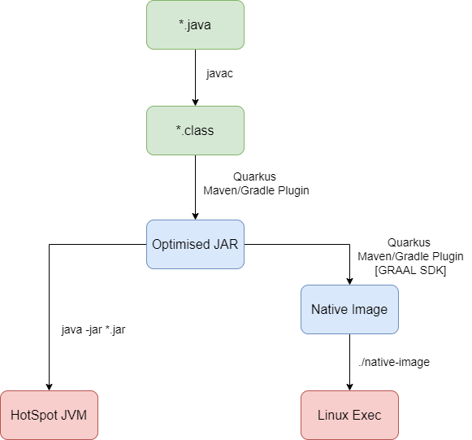
What is Quarkus – Build/Run Process

Slide 9
About GraalVM
GraalVM is a Java VM and JDK Implementation based on OpenJDK, implemented in Java.
Main Differentiators:
The JIT compiler is developed with Java
It supports ahead-of-time compilation of Java applications with Native-Image for fast startup and low memory footprint.
It supports additional programming languages(Python, Ruby, R, C++, GO)

Slide 10
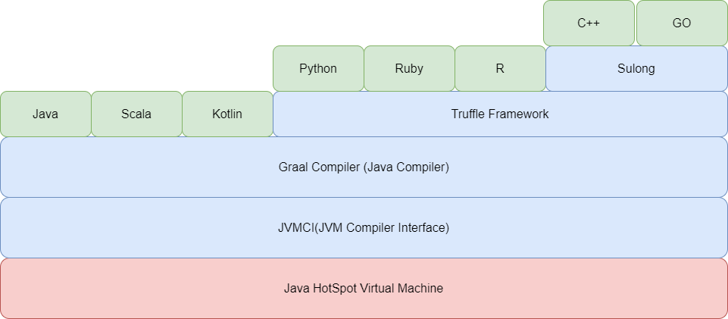
About GraalVM

Slide 11
The good and bad

Slide 12
The Good – As Developer
Extended Hot Reload for Dev profile
Developer Friendly error/exception management for Dev profile
Build Time Optimization
Unified Configuration with support on major libraries (eg: Kafka, Redis, DB)
Hussle Free support for Native Compilation for major libraries.
CI/CD support in Maven touching Native, Docker, Kubernetes.
Spring annotations support

Slide 13
The Good – As Architect
Low memory consumption
Better startup time even without Native
It is based on a fully reactive and non-blocking architecture

Slide 14
The Not so Good
Extensions have good degree of coverage but still are libraries missing. And is a high dependency on this when it comes to performance
Documentation is good to kickstart but if you encounter specific issues there is little adoption to compare the coverage Spring has.
No frontend officially released, there are projects in that direction still under development.
Adoption on large implementation is still lacking

Slide 15
Metrics

Slide 16
First Successful Request
The time until first successful API call is returned.

Slide 17
Total Memory Consumption - RSS
The total memory used in container for the process at startup

Slide 18
Performance over time - GET
The average response time in a JMeter test with 10k GET Operations

Slide 19
Performance over time - POST
The average response time in a JMeter test with 10k POST Operations

Slide 20
Takeway

Slide 21
Microservices
I will choose to use Quarkus for Microservices if :
All libraries required are covered by Extensions
Team is familiar with JavaEE rather than Spring
Project has unpredictable and short span scalability concerns, but resources must be kept at minimum
Cons:
Far easier to find Spring expertise than on CDI/JavaEE and microservices
I will not consider native images for microservices especially due to the Hussle on debugging and analyzing native applications for java developers

Slide 22
Serverless
I will use Quarkus for Severless if :
NodeJs is not an option for development
Libraries are covered by Quarkus with Native support to benefit from performance boost
Note:
Worm-up instances in Severless do not make much sense for cost optimisation, so choosing Java for Severless should come with Native Image.

Slide 23
Project Migration
I will use Quarkus for Project Migration if:
The project is developed based on JavaEE technologies
All libraries are part of Quarkus
Note:
I will not use the Quarkus framework to migrate Spring based since the overhead of migration is not translated in sufficient benefits after migration.

Slide 24
Functional POCs
I will use Quarkus for POCs:
Always ☺, I like the super fast process from code to deployment.

Slide 25
Coding Session

Slide 26


Slide 27
Q&A

